Slide 1
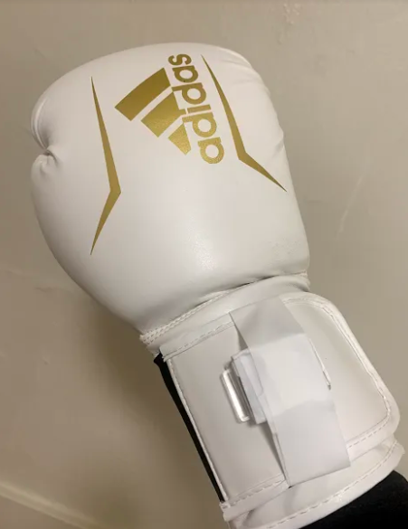
Boxing Wearable
Andrew Pham

Slide 2
Introduction
Cardio Boxing
Non Contact
Great Exercise
Great Practice
The Wearable
SensorTile on wrist
Worn over glove
Data Streaming
Coaching

Slide 3
Specific Aims
Punching Mechanics
Type
Velocity
Quickness
Coaching Aid and Stand-In

Slide 4
Methods
SensorTile
Accelerometer determines power
Gyroscope Determines Type
Simple scoring for coaching and gaming
Modes
Prompt
Detect
Game

Slide 5
Defining Punches
Cross: full rotation, full travel time, hard
Hook: no rotation, full travel time, hard
Jab: small rotation, quick, light

Slide 6
Prompted and Coaching
Boxer is given a prompt
jab, hook, cross, hook, jab
https://drive.google.com/file/d/1Ep2fksGZA_aL1AiIDJqNUFGmBQwg3ITx/view?usp=sharing

Slide 7
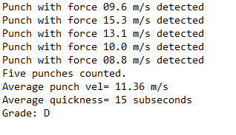
Prompted and Coaching
Boxer is given a prompt
jab, hook, cross, hook, jab
Punches are recorded
Boxer is given a summary
Boxer given grade based off average punch velocity and quickness

Slide 8
Detection Examples
https://drive.google.com/file/d/1C5nxkR4n_5LZjoBL39vc4hQwfyMQKL8D/view?usp=sharing
https://drive.google.com/file/d/1UMuB3VnYSiKTJ_nptxpAIZydnkiKb5-w/view?usp=sharing
https://drive.google.com/file/d/1t9-JWaKwdJQctZFjafdsVA-X7nl-S6nU/view?usp=sharing
https://drive.google.com/file/d/1PSIsBd-gd9g181Twifwws77km1Y4yIPA/view?usp=sharing

Slide 9
Detection Results
Jabs: | Cross | Jab | Cross | Jab | Jab | Cross | Jab | Jab | Jab | Jab
Cross: | Cross/J | Cross/J | Cross | Cross/J | Jab | Cross | Cross/J | Cross | Cross | Jab
Hooks: | Jab | Jab | Hook | Cross | Cross | Jab | Hook | Cross | Hook | Hook
Jabs: 70% accurate
Crosses: 90% “accurate”
False positives from snapback
30% accurate actually
Hooks: 40% accurate

Slide 10
Detection Intuition
Boxer punches, device detects punch data
Works okay shadowboxing
78% accuracy, nearly 100% accurate at medium speed
Needs calibration for “bag work”
More accurate vs a real bag instead of wall
Hard punches disrupt the gyro

Slide 11
The Real Issue
Punching Detection
Accuracy Rate
78% accurate shadowboxing
40% accurate boxing vs bag wall
Can Machine Learning Help?

Slide 12
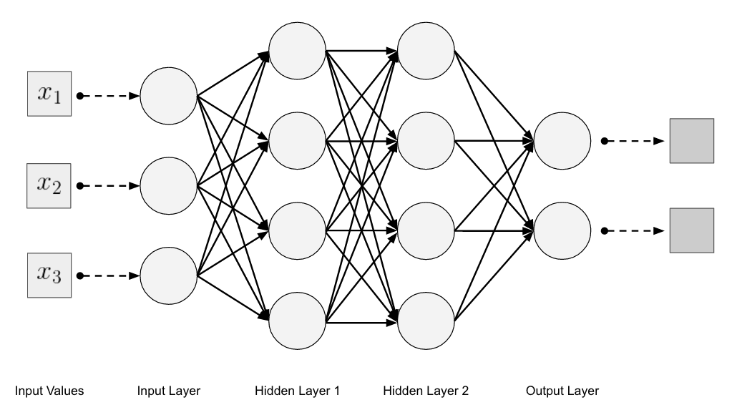
Machine Learning punches
Classification Problem
Inputs
3D ACC
3D GYRO
Quickness Timer
Layers
Timing and Rotation
Training and Backprop
Test set and outputs

Slide 13
Conclusion
Shadow boxing sensor
Takeaways
What’s Next?
Wireless
Built into glove
Impact Velocity
Coaching
KNES & Medicine

